Slide 2
Effective EPR Strategies: Challenges, Opportunities and Resource Mobilization in Developing Countries
Extended Producer Responsibility places the manufacturers at the heart of managing the end-of-life products
Producers and Manufacturers of EEE
Execute buy-back initiatives
Facilitate recycling of e-waste
Pay government levies
Establish and maintain recycling centres
Adopt and maintain environmentally friendly production techniques
Government:
Laws and Regulations
Oversight bodies (e.g. NEMA)
Revenue collection
Notes:
First slide is the topic and presenter’s name

Slide 3
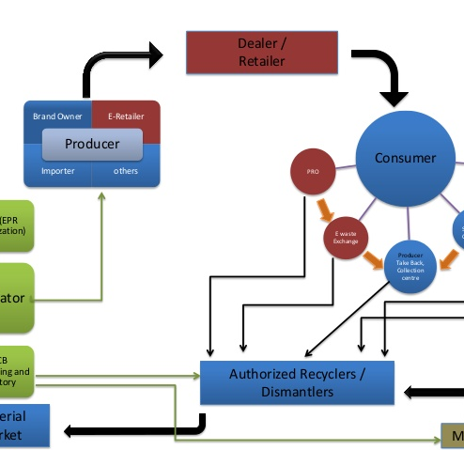
Effective Extended Producer Responsibility
Providing a check-list of qualifications by producers to benefit from subsidized advertisement
Collaboration with the media to enhance awareness and promote buy-back initiatives
Creation of interaction lines between producers, marketers and collectors and leading user institutions
Active participation of producers in the creation of EPR implementation strategies

Slide 4
Effective EPR Strategies
E-waste management funding model that compensates producers for spearheading take-back initiatives
Provide additional funds for recycling programs at the collection level through revolving cooperative outfits
Creation of collection centres at institutions of higher learning and leading EEE resellers with direct link to producers
Devise a national environmental-safety fund to which consumers, collectors and recyclers will contribute to enhance government participation in offering oversight role
Notes:
Talk about strategies that EPR have in place, have you identified one? Or this is purely theory based

Slide 5
Cost-spreading options
Television Station firms
Newspaper Printing firms
Radio Station firms
FUNDING POOL FOR EFFECTIVE EPR
STRATEGIES
Recyclers
Marketers of EEE
Government

Slide 6
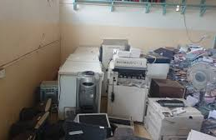
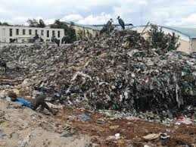
Challenges facing EPR
Lack of funding for implementing identified strategies
Government-focused strategic interventions
Limited public knowledge of e-waste as an environmental hazard coupled with risky informal e-waste collection and recycling sector
Lack of Capacity building and awareness by producers
Financial insecurity by Producers (profit loss exposure)
Lack of inter-stakeholder financial models
Inadequate collaborations with leading consumers of EEE e.g. Universities, Media houses
Recycling of used EEE from developed to developing countries

Slide 7
Opportunities Of EPR
Providing a check-list of qualifications by producers to benefit from tax-free advertisement in local media
Introducing regulations that place a demand on media houses, both electronic and print, to run awareness campaigns in collaboration with producers with the aim of encouraging buy-back programmes and safe-recycling options
Rewarding compliant primary and secondary producers of EEE for engaging in e-waste environmental through annual national environmental champion awards.
Recognition and sensitization of e-waste management as a profitable business venture through creation of e-waste co-operative societies to martial grass-root involvement while inspiring profitability and safety

Slide 8
Action Plan
Engage producers actively in the making of strategic plans for e-waste management to reduce resistance in implementation
Create mechanisms for producers to empower collectors of e-waste as change agents and cascade basic user information to be disseminated at grassroot levels through cooperative-like formations
Creation of multi-level collection centres at Universities (e.g. Maseno University, Multi-Media University and Jomo Kenyatta University of Agriculture and Technology) leading resellers (e.g Safaricom Ltd, Airtel-Telkom Ltd etc) with incentives to motivate participation and regulation by NEMA for compliance
Introduction of trainers to sensitize EEE consumers on benefits of buy-back initiatives
Collaboration with leading media houses to promote public awareness

